Slide 1

Introduction of Programming Languages
Pálinkás Zoltán

Slide 2
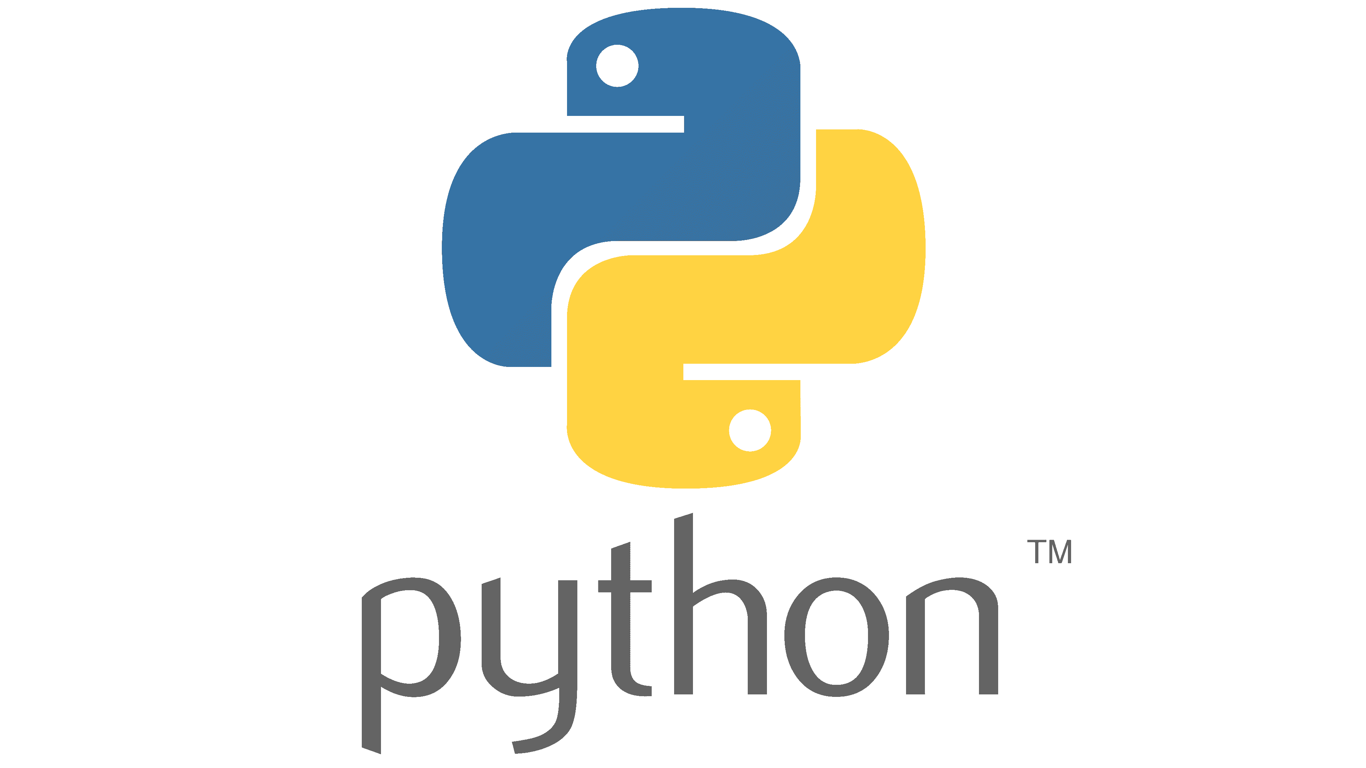
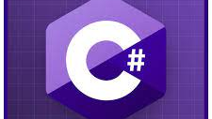
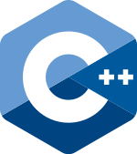
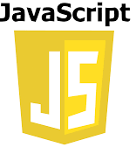
Popular programming languages ​​today!

Slide 3
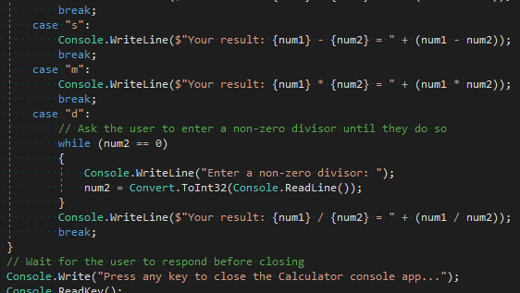
C#
Developed by Microsoft
Used on Windows systems

Slide 4
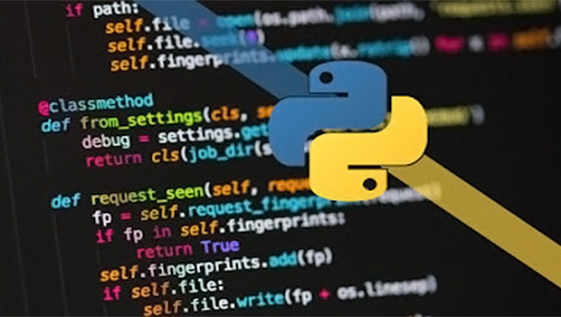
Pyhton
Designed by Dutch programmer Rossum
User friendly
Relatively easy to learn

Slide 5
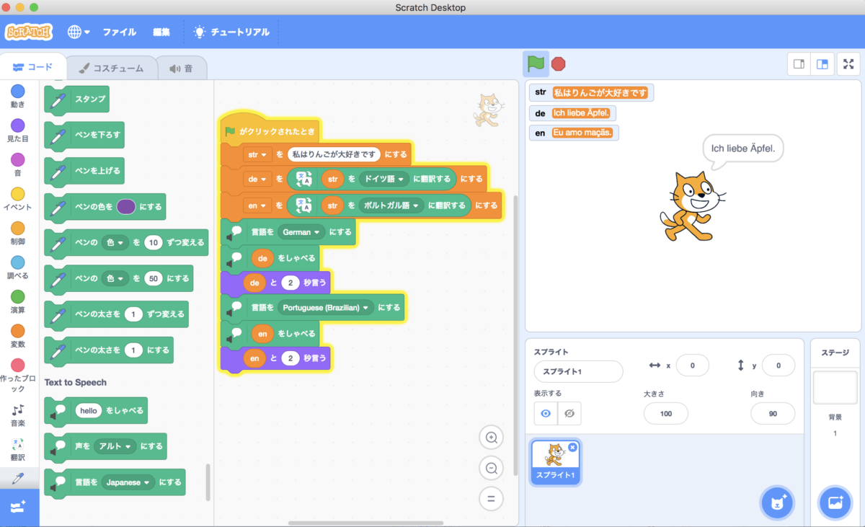
Scratch
Perfect for children
Playful programming

Slide 6

Thank you for your attention!

